Slide 1
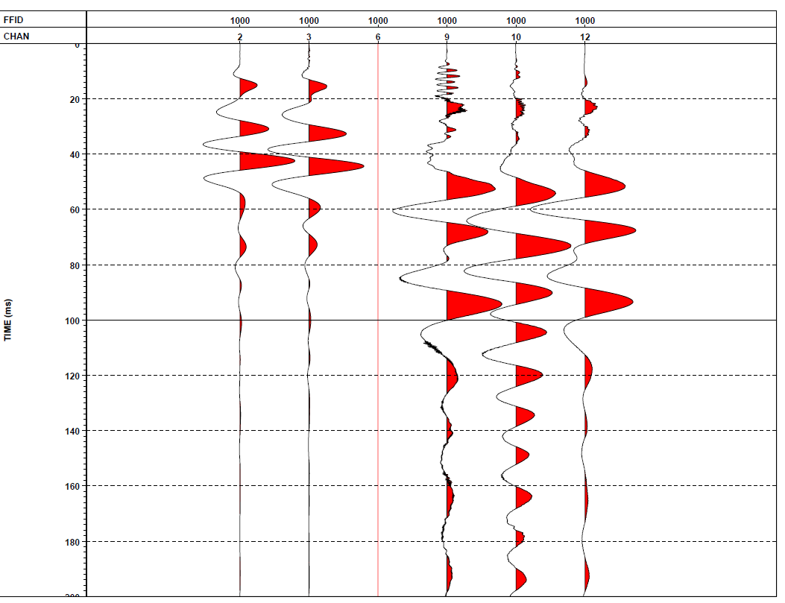
Well plant
satisfactory plant
round platform
Wooden platform
Drone

